Slide 1

10. Seerat of
Holy Prophet (S.A.W.W) II
(BATTLE OF UHUD)
Course Instructor
Islamic Studies:
Mufti Omer rafique

Slide 2
BATTLE OF UHUD:
Battle of Uhud was a revenge of battle of badr from the side of Non -Muslims in the history of Islam. Due to the victory of Muslims in the battle of badr, the Non-Muslims of Makkah were very angry and started preparation for war as a revenge.
Therefore, in 3rd Hijra an army of three thousand soldiers in the leadership of Abu Sufyan with full weapons marched towards Madinah and reached near to the mountain of uhud. Mean while Holy Prophet(S.A.W) called the companions and asked for their decision. Every Sahabi(R.A) was ready for war. Holyprophet(S.A.W) prepared 1000 soldiers and started to march towards the mountain of uhud. During the journey, the leader of the hypocrites, Abdullah ibn-e-ubai, ibn-e-salool separated from the army of holy Prophet(S.A.W).

Slide 3
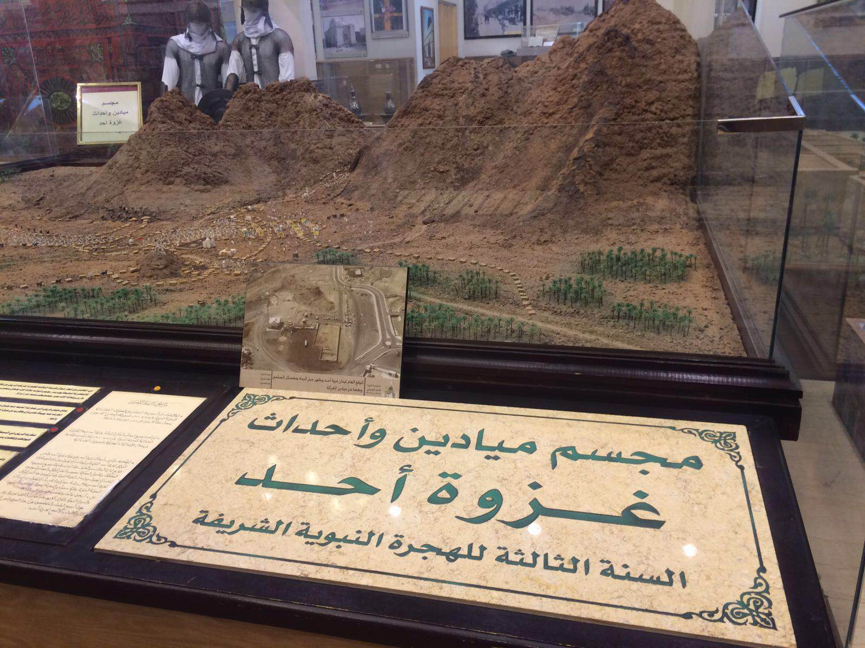

Slide 4
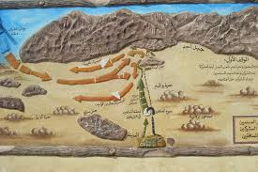

Slide 5
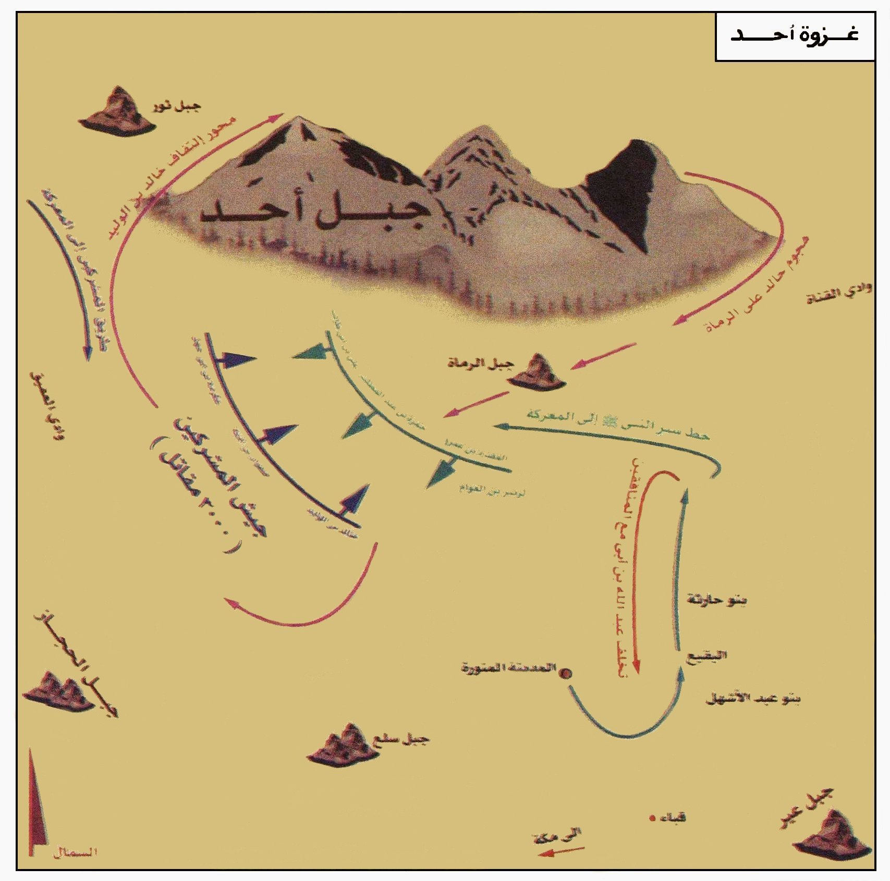

Slide 6
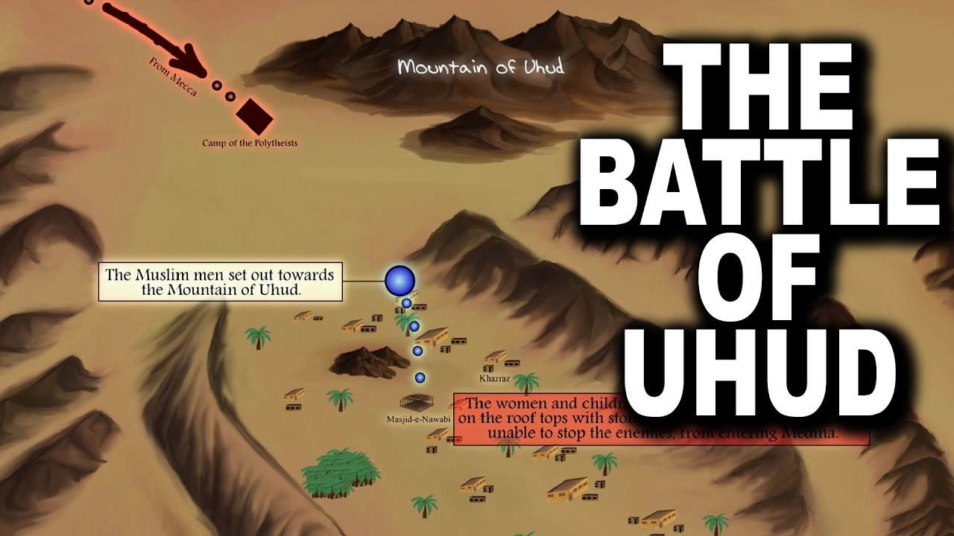

Slide 7
Now the total number of Muslim army was seven hundred and the both armies were in front of each other. Before starting the war, Holy Prophet (SAW) placed a number of fifty Muslim soldiers on the top of the mountain.
The war was started and the Muslim army in the leadership of Holy Prophet(SAW) attacked on the non-Muslim army with full force, therefore the non-muslims did not bear the attack of the Muslims and started to left the place of Battle. Initially Muslim army achieved victory. But the fifty soldiers which were placed on the top of mountain by holy Prophet(SAW), left their place because they thought that Muslim have won the battle.

Slide 8
The non-Muslims again attacked from the same place on the Muslims and the Muslims got unbalanced. Therefore, the forehead of Holy Prophet(SAW) was badly wounded, His teeth were broken and he fell down in the trench.
When it was conformed that the Holy Prophet(S.A.W) is alive, then again Muslim soldiers collected their force but the non-Muslims left the place of war without any decision and returned back to Makkah. In this Battle seventy companions of Holy Prophet(SAW) got martyred and twenty two non-Muslims were killed.

Slide 9
BATTLE OF KHANDAQ/ AHZAB/
TRENCH:
This battle was fought in fifth Hijrah.
Combined military forces including non-Muslims of Makkah, jews and many tribes participated in this battle.
Ahzab means combined military forces.
The leader/commander of the non-Muslims was Hazrat Abu Sufyan.
The total number of Muslim forces/army was three thousands.

Slide 10
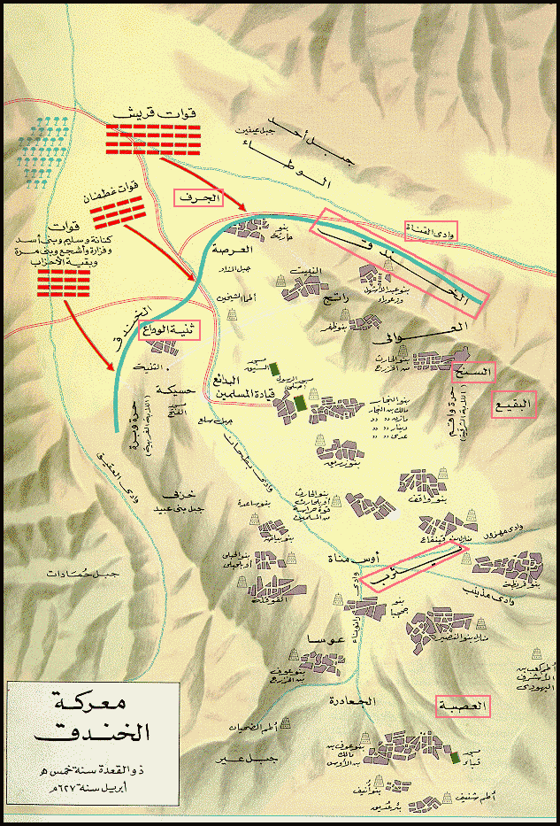

Slide 11
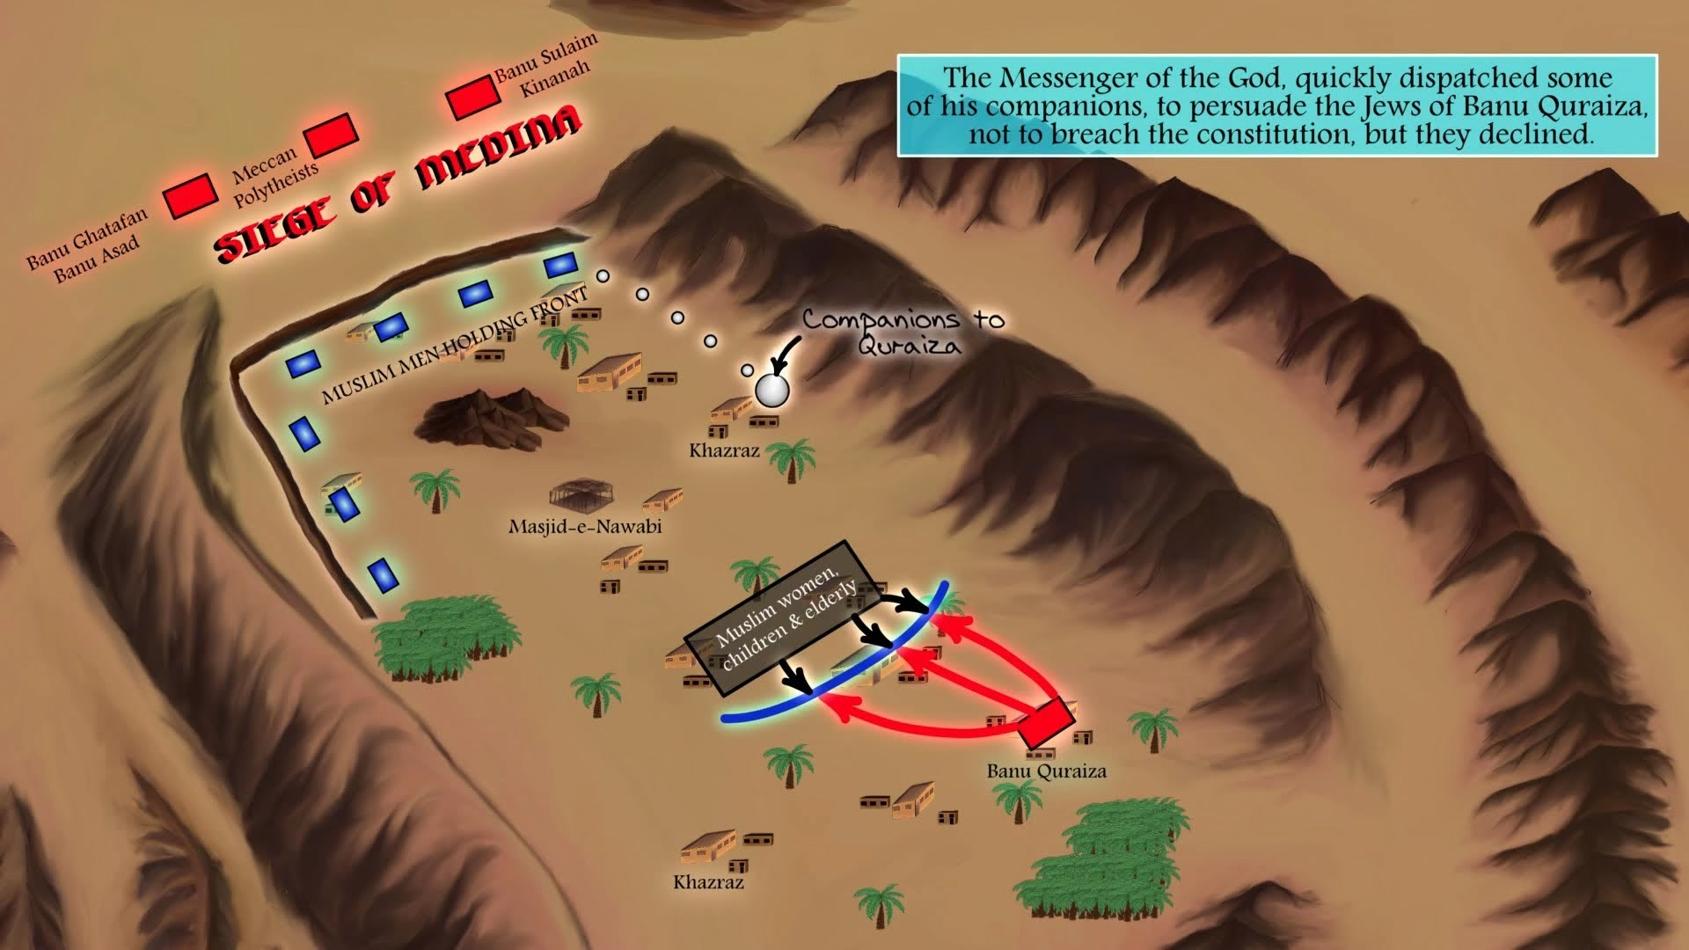

Slide 12
Total number of non-Muslim forces was 10000.
With the advise of Hazrat Salman Farsi(R.A), a new technique was adopted and the trenches were dig out for the safety of Madinah from three sides. The total depth was 5 yards.
Holy Prophet (SAW) himself participated for the digging of the trenches.
Non-Muslim forces surrounded Madinah for one month but did not cross the trenches.
The non-Muslims were facing difficulties and hardship.
Allah gave special help for believers by fast wind and also tension and cold wind defeated enemy.
Due to fast wind, their tents became disbalanced and they left the place of battle without any decesion.

Slide 13
Treaty Of Hudaibyah
In 6th Hijrah, Holy Prophet(SAW) decided to proceed Makkah for the performance of Umrah
He prepared his companions for this Umrah
1400 Sahaba-e-Karam were with Him
Non-Muslims of Makkah prepare for war
Holy Prophet(SAW) sent Hazrat Usman(R.A) with message that we did not come here for fighting but only to perform Umrah
After the departure of Hazrat Usman (R.A), it was announced that Hazrat Usman (R.A) has been killed in Makkah.
Holy Prophet (SAW) taken an oath from Sahab-e-Ikram for the revenge of Hazrat Usman (R.A) which is known as Bait-e-Rizwan.

Slide 14
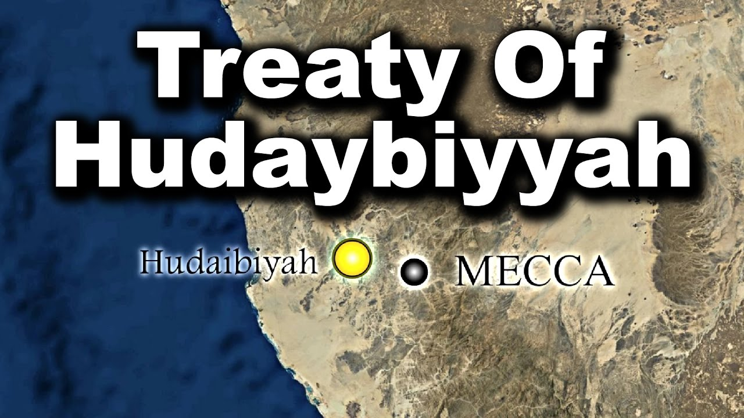

Slide 15
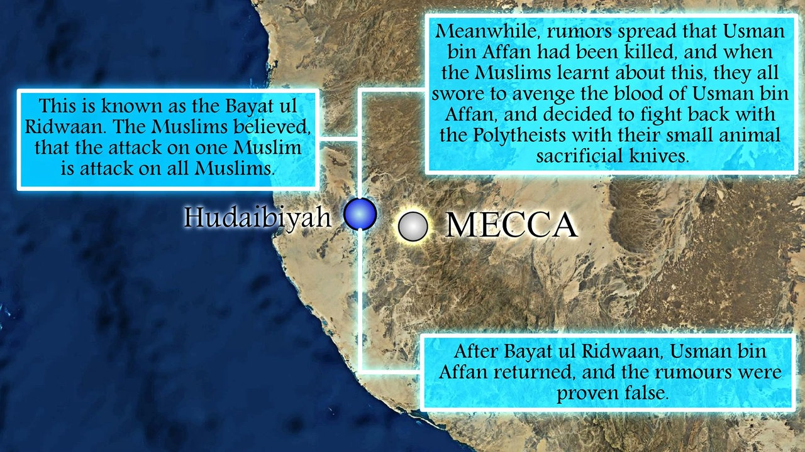

Slide 16
The news was false as Hazrat Usman (R.A) came back and the Non Muslims of Makkah sent Sohail Bin Amar for an agreement with the Muslims.
A treaty (Agreement) was signed at the place of Hudaibiya with the following points.
1. Go back this year without Umrah.
2. Come next year only for three days.
3. You will come without weapons.
4. If any Muslim or Non Muslim will reach at Madinah from Makkah he would be sent back to Makkah.
5. If any Muslim will reach at Makkah he would not be sent back to Madinah.
6. The Arab tribes are free to join Muslims or Non Muslims.
7. This agreement is for ten years.

Slide 17
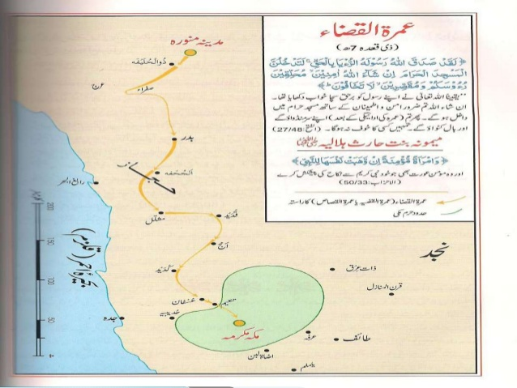

Slide 18
The Conquest Of Makkah
Holy Prophet (SAW), due to the violation of Treaty of Hudaibia prepared his companions to attack on Makkah in 8th Hijrah.
He marched towards Makkah with 10,000 strong army.
The Great Prophet SAW issued the following instructions to the Islamic Army before entering Makkah.
1)Any body who surrender should not be killed.
2)Whoever takes shelter in the house of Hazart Abu Sufiyan would not be killed.
3)Those who tried to run away,should not be killed.
4) Those who close their house door should not be killed.

Slide 19
5) Old people, ladies and childern should not be killed.
Islamic army entered Makkah in peace.
After reaching Makkah Holy Prophet (SAW) performed Umrah.
Then Holy Prophet (SAW) entered into Kabbah and remove 360 idols placed by the Non-Muslims of Makkah.
During the demolation he was reciting “Turth has come and falsehood removed,and falsehood should be removed”
Then he called the Makkan people infront of him, those who have done many mistakes and asked what do you expect from me.When everybody lowered his head with shame then he said” May Allah pardon you, you are free today and there is no Burden on you today”.
Without leaving a single soldier in conquered city , he return back to Madinh and the conquest of Makkah was completed.

Slide 20
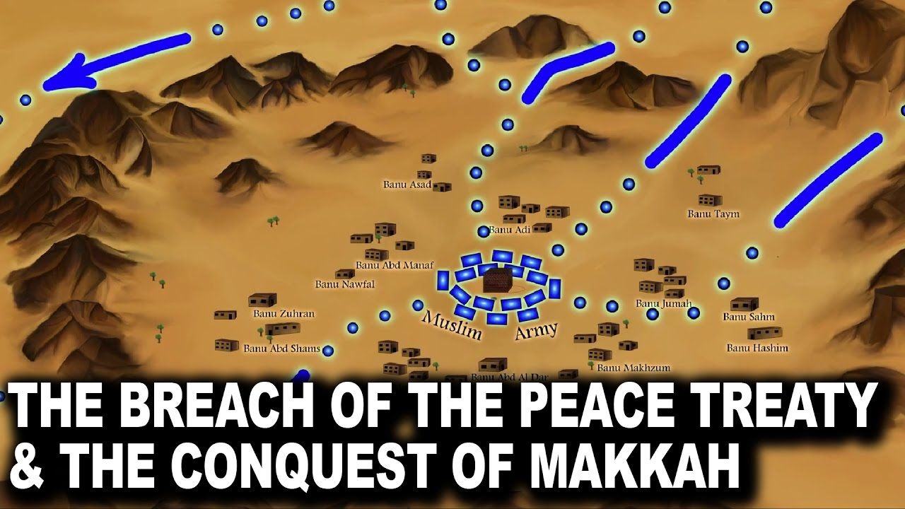

Slide 21
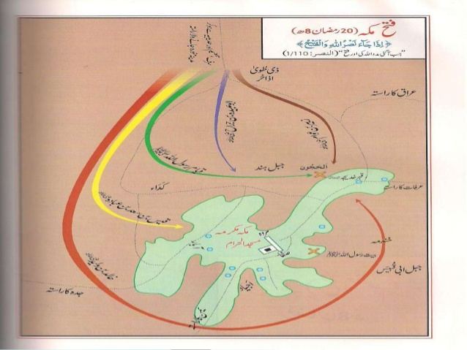

Slide 22
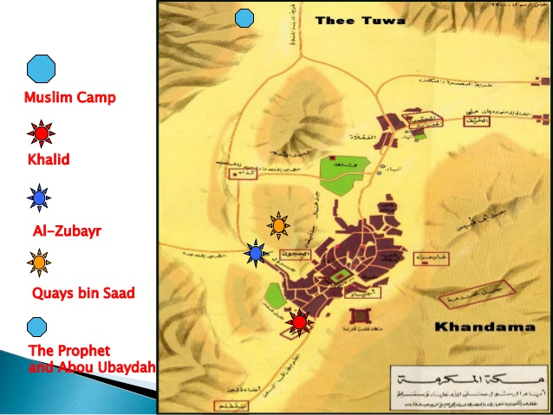

Slide 23
Hajat-ul-wida
In 10th hijrah, Holy Prophet (SAW) performed his first and last hajj.
At the place of Arafat, he delivered his famous address (speech) which is know as Khutba-hajjatul-wida in islamic history.
He delivered his message in front of one lakh twenty four thousand companions and he mounted on his camel Qaswa.
This sermon is the last speech of Holy Prophet (SAW) which is the conclusion and summary of his whole teaching.

